Slide 1
Spring 3
“Develop Enterprise Applications Easier”
May-Jun 2014
Technical Solutions Team

Slide 2
Scope
Springing into Action
Wiring beans
Minimizing XML configuration in Spring
Aspect-oriented Spring
Hitting the database
Managing Transactions
Building web applications with Spring MVC
Working with Spring Web Flow
Securing Spring
Working with remote services
Getting Spring some REST
Messaging in Spring
Managing Spring beans with JMX
Odds and Ends
Reference: Spring in Action 3d Edition by Craig Walls

Slide 3
Part 1: Core Spring
Core Parts:
Dependency Injection
Aspect-oriented Programming
Topics:
Springing into Action – quick overview of DI and AOP
Wiring Beans – Spring’s XML-based config
Minimizing XML c onfiguration in Spring
Aspect-oriented Spring – decouple systemwide services from the objects they service

Slide 4
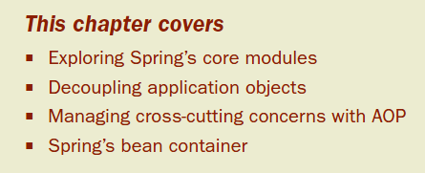
Chapter 1: Springing into action
It all started with a bean
Javabeans - defined a set of coding policies that enabled simple Java objects to be reusable and easily composed
EJB –extended the notion of Java components to the server side, providing much-needed enterprise services
Notes:
In December1996, Sun Microsystems published the JavaBeans 1.00-A specification. JavaBeans defined a software component model for Java. This specification defined a set of coding policies that enabled simple Java objects to be reusable and easily composed into more complex applications. They seemed too simple to be capable of any “real” work.
-Sophisticated applications often require services such as transaction support, security, and distributed computing—services not directly provided by the JavaBeans specification
-EJB never achieved its intended purpose: to simplify enterprise application development.

Slide 5
EJB’s declarative programming model simplifies many infrastructural aspects of development, such as transactions and security
EJBs complicate development by mandating deployment descriptors and plumbing code (home and remote/local interfaces)
Today: New programming techniques, including aspect-oriented programming (AOP) and dependency injection (DI), are giving JavaBeans much of the power previously reserved for EJBs
Spring Framework-lightweight POJO-based development
EJB 3 – ‘too little, too late’

Slide 6
1.1 Simplifying Java development
open source framework originally created by Rod Johnson
address the complexity of enterprise application development, and makes it possible to use plain-vanilla JavaBeans
Spring’s key strategies:
Lightweight and minimally invasive development with plain old Java objects (POJOs)
Loose coupling through dependency injection and interface orientation
Declarative programming through aspects and common conventions
Boilerplate reduction through aspects and templates

Slide 7
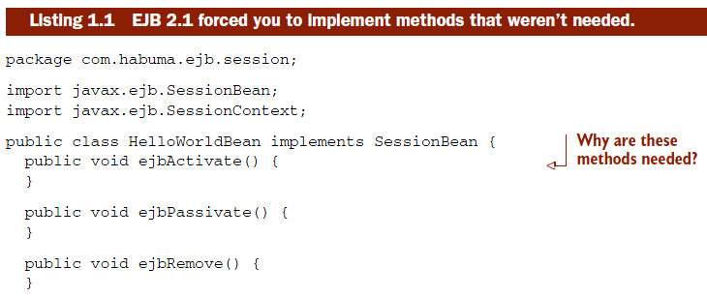
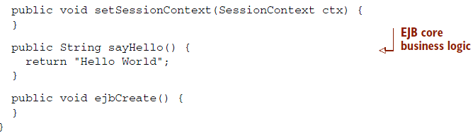
1.1.1 Unleashing the power of POJOs
Notes:
The bulk of the code in HelloWorldBean is there solely for the sake of the framework. This raises the question: who’s working for whom?

Slide 8
Other popular frameworks such as the earlier versions of Struts, WebWork, and Tapestry imposed themselves upon otherwise simple Java classes.
unnecessary code, locked into their framework, and were often difficult to write tests against
Spring –
avoids (AMAP) littering your application code with its API.
almost never forces you to implement a Spring-specific interface or extend a Spring-specific class
At worst, a class may be annotated with one of Spring’s annotations, but is otherwise a POJO

Slide 9
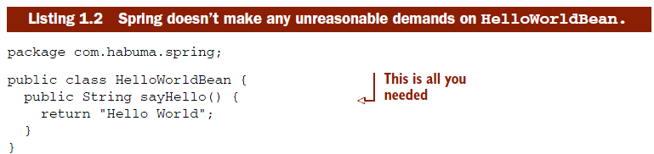
Gone are all of those noisy lifecycle methods. doesn’t implement, extend, or even import anything from the Spring API
Hello- WorldBean is lean, mean, and in every sense of the phrase, a plain-old Java object

Slide 10
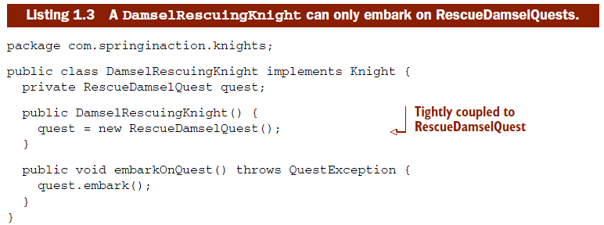
1.1.2 Injecting dependencies
The phrase dependency injection may sound intimidating
By applying DI in your projects, you’ll find that your code will become significantly simpler, easier to understand, and easier to test
Notes:
-verify DamselRescuingKnight.java

Slide 11
Coupling is a two-headed beast
On one hand, tightly coupled code is difficult to test, difficult to reuse, difficult to understand, and typically exhibits “whack-a-mole” bug behavior (fixing one bug results in the creation of one or more new bugs)
On the other hand, a certain amount of coupling is necessary—completely uncoupled code doesn’t do anything. In order to do anything useful, classes need to know about each other somehow.

Slide 12
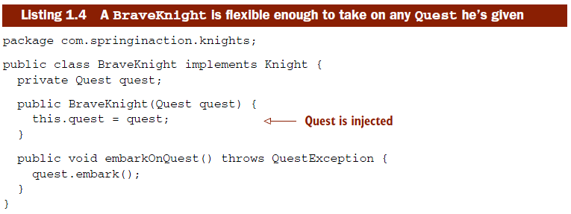
With DI, on the other hand, objects are given their dependencies at creation time by some third party that coordinates each object in the system
Objects aren’t expected to create or obtain their dependencies—dependencies are injected into the objects that need them
Notes:
-verify BraveKnight.java

Slide 13
As you can see, unlike DamselRescuingKnight, BraveKnight doesn’t create his own quest. Instead, he’s given a quest at construction time as a constructor argument. This is a type of dependency injection known as constructor injection.
What’s more, the quest he’s given is typed as Quest, an interface that all quests implement. So BraveKnight could embark on a RescueDamselQuest, a SlayDragon Quest, a MakeRoundTableRounderQuest, or any other Quest implementation he’s given.
key benefit of DI—loose coupling
Swapping easily with different implementations

Slide 14
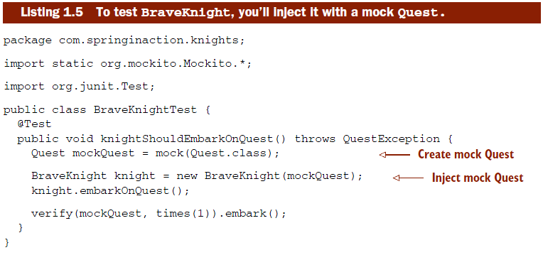
Notes:
-Run BraveKnightTest as Junit
-Here you’re using a mock object framework known as Mockito to create a mock implementation of the Quest interface. With the mock object in hand, you create a new instance of BraveKnight, injecting the mock Quest via the constructor. After calling the embarkOnQuest() method, you ask Mockito to verify that the mock Quest’s embark() method was called exactly once.

Slide 15
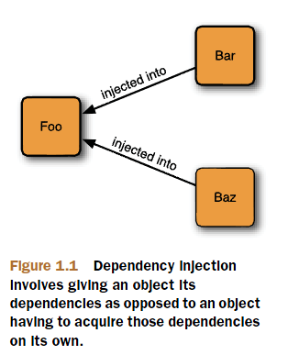
INJECTING A QUEST INTO A KNIGHT
Now that your BraveKnight class is written in such a way that you can give him any quest you want, how can you specify which Quest to give him?
The act of creating associations between application components is commonly referred to as wiring.
Common approach: via XML(Spring Config File)

Slide 16
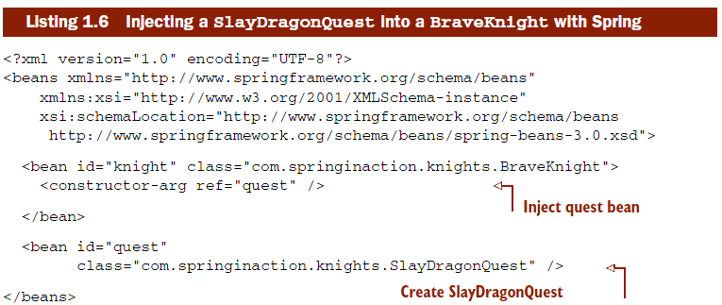
This is a simple approach to wiring beans in Spring.
Notes:
-verify knights.xml

Slide 17
SEEING IT WORK
In a Spring application, an application context loads bean definitions and wires them together
Spring comes with several implementations of its application context
Because the beans in knights.xml are declared in an XML file, an appropriate choice for application context might be ClassPathXmlApplicationContext

Slide 18
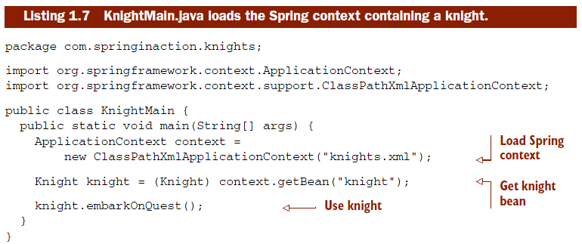
Here the main() method creates the Spring application context based on the knights.xml file
Notes:
-verify KnightMain.java

Slide 19
Exercise 1-1
By running KnightMain.java configure the Spring context so that the Knight will do the following(instead of Slaying Dragon):
1. Rescuing damsel in distress
2. Making round table rounder

Slide 20
1.1.3 Applying aspects
Although DI makes it possible to tie software components together loosely, aspect- oriented programming enables you to capture functionality that’s used throughout your application in reusable components
technique that promotes separation of concerns within a software system
System services such as logging, transaction management, and security
cross-cutting concerns
Notes:
These system services are commonly referred to as cross-cutting concerns because they tend to cut across multiple components in a system.

Slide 21
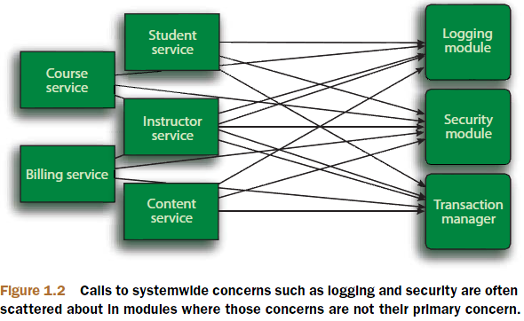
By spreading these concerns across multiple components
The code that implements the systemwide concerns is duplicated across multiple components
Your components are littered with code that isn’t aligned with their core functionality
Notes:
○ The code that implements the systemwide concerns is duplicated across multiple components. This means that if you need to change how those concerns work, you’ll need to visit multiple components. Even if you’ve abstracted the concern to a separate module so that the impact to your components is a single method call, that method call is duplicated in multiple places.
○ Your components are littered with code that isn’t aligned with their core functionality. A method to add an entry to an address book should only be con- cerned with how to add the address and not with whether it’s secure or transactional.
Not only does each object know that it’s being logged, secured, and involved in a transactional context, but also each object is responsible for performing those services for itself.

Slide 22
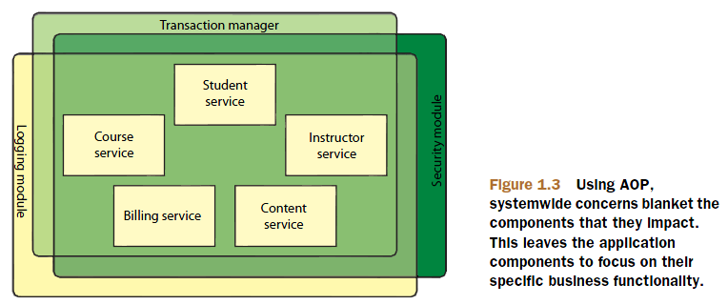
AOP makes it possible to modularize these services and then apply them declaratively to the components that they should affect
Results in components that are more cohesive and that focus on their own specific concerns, completely ignorant of any system services that may be involved. POJOs remain plain

Slide 23
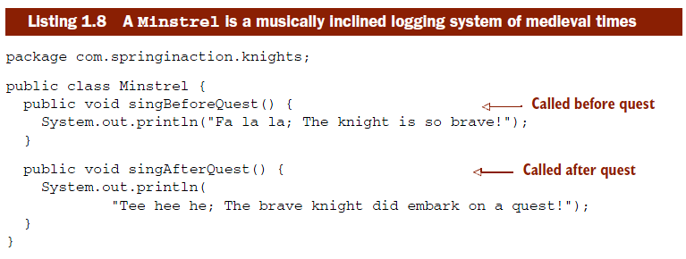
AOP IN ACTION
Notes:
-Anyone who knows anything about knights only knows about them because their deeds were chronicled in song by the musically inclined storytellers known as minstrels.
-As you can see, Minstrel is a simple class with two methods. The singBeforeQuest() method is intended to be invoked before a knight embarks on a quest, and the singAfterQuest() method should be invoked after the knight has completed a quest. It should be simple to work this into your code, so let’s make the appropriate tweaks to BraveKnight to use the Minstrel.
-Code this to BraveKnight

Slide 24
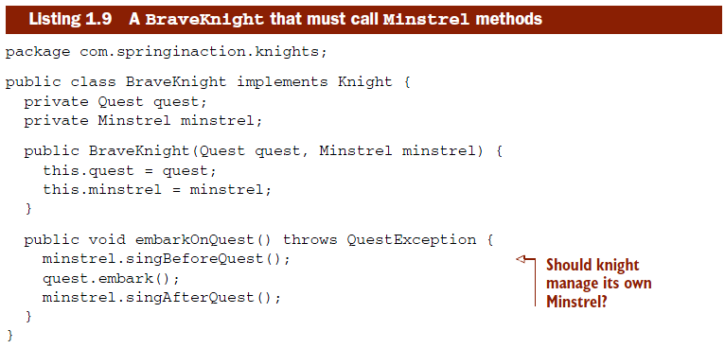

Slide 25
Is it really within the knight’s range of concern to manage his minstrel?
It seems to me that a minstrel should just do his job without the knight asking him to do so. After all, that’s the minstrel’s job—to sing about the knight’s endeavors.
Why should the knight have to keep reminding the minstrel to do his job?
Furthermore, because the knight needs to know about the minstrel, you’re forced to inject the Minstrel into the BraveKnight
What if the Minstrel is null? Should we introduce some null-checking logic to cover that case?
Your simple BraveKnight class is starting to get more complicated and would become more so if you were to handle the nullMinstrel scenario

Slide 26
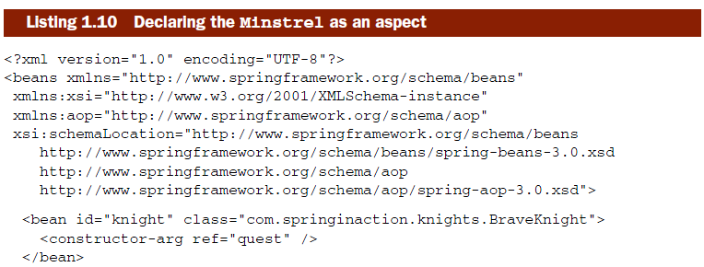
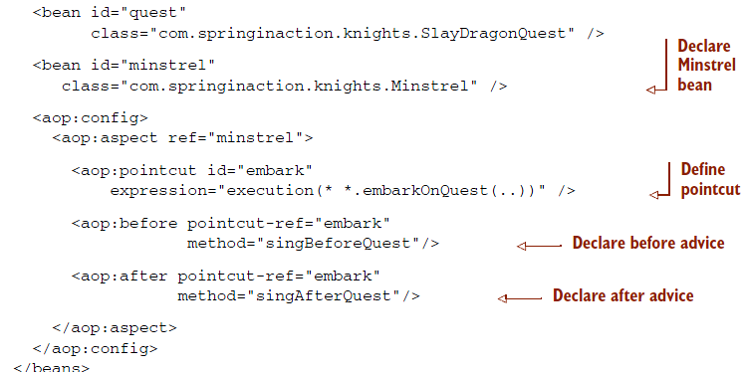
Using AOP

Slide 27
Steps:
Declare bean
refer to that bean in the <aop:aspect> element
Define pointcut – where advices should be applied
Before advice
After advice
Notes:
-verify knights-aop.xml
-run KnightAopMain.java

Slide 28
Exercise 1-2
Create a java class “KnightAopMain.java”. From this class’s main method, create a Spring Application context using “knights-aop.xml” as config file. You should be able to get an instance of Knight and embark a quest.
The minstrel should be able to do his function to sing before and sing after each quest(using AOP). You will have to modify “knights-aop.xml” to achieve this.

Slide 29
two important points to take away from the example:
Minstrel is still a POJO
Minstrel can be applied to the BraveKnight without the BraveKnight needing to explicitly call on it

Slide 30
1.1.4 Eliminating boilerplate code with templates
Have you ever written some code and then felt like you’d already written the same code before? That’s not déjà vu, my friend. That’s boilerplate code!

Slide 31
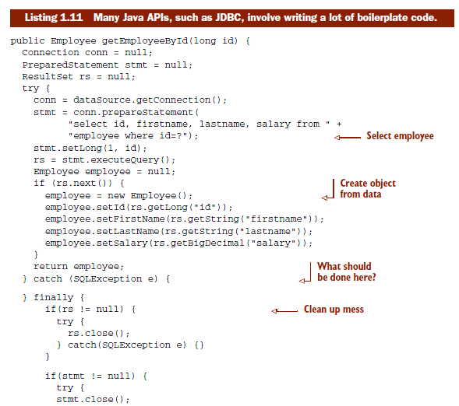

Slide 32
JDBC’s not alone in the boilerplate code business. Many activities often require similar boilerplate code. JMS, JNDI, and the consumption of REST services often involve a lot of commonly repeated code
Spring seeks to eliminate boilerplate code by encapsulating it in templates.
Spring’s JdbcTemplate makes it possible to perform database operations without all of the ceremony required by traditional JDBC.

Slide 33
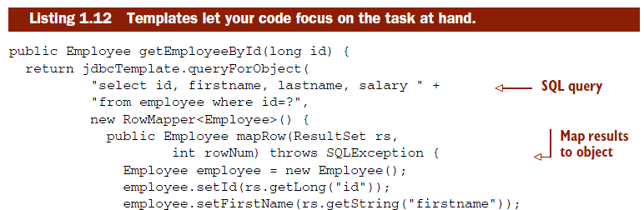
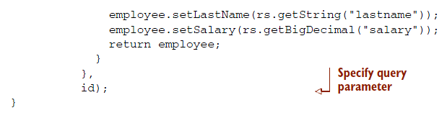
Notes:
-What you don’t see in get- EmployeeById() is any of the JDBC boilerplate from before. It’s all handled internal to the template.

Slide 34
So far:
POJO-oriented development, dependency injection, AOP, and templates
how to configure beans and aspects in XML-based configuration files
But how do those files get loaded? And what are they loaded into? Let’s look at the Spring container, the place where your application’s beans will reside

Slide 35
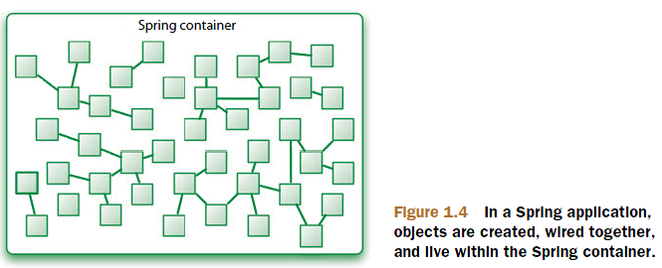
1.2 Containing your beans
In a Spring-based application, your application objects will live within the Spring container

Slide 36
Understanding the container helps you grasp how your objects will be managed.
The container is at the core of the Spring Framework
Spring’s container uses dependency injection (DI) to manage the components that make up an application
As such, these objects are cleaner and easier to understand, support reuse, and are easy to unit test

Slide 37
Spring comes with several container implementations that can be categorized into two distinct types
Bean factories (defined by the org.springframework.beans.factory.BeanFactory interface) are the simplest of containers, providing basic support for DI
Application contexts (defined by the org.springframework.context.ApplicationContext interface) build on the notion of a bean factory by providing application framework services, such as the ability to resolve textual messages from a properties file and the ability to publish application events to interested event listeners

Slide 38
Although it’s possible to work with Spring using either bean factories or application contexts, bean factories are often too low-level for most applications. Therefore, application contexts are preferred over bean factories

Slide 39
1.2.1 Working with an application context
Spring comes with several flavors of application context. The three that you’ll most likely encounter are
ClassPathXmlApplicationContext—Loads a context definition from an XML file located in the classpath, treating context definition files as classpath resources
FileSystemXmlApplicationContext—Loads a context definition from an XML file in the file system
XmlWebApplicationContext—Loads context definitions from an XML file contained within a web application

Slide 40
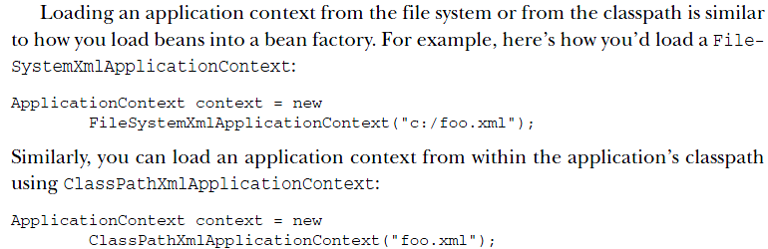
With an application context in hand, you can retrieve beans from the Spring con- tainer by calling the context’s getBean() method.

Slide 41
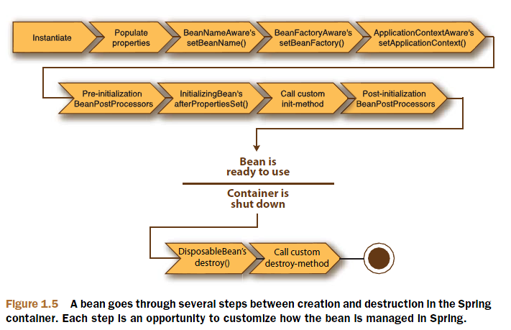
1.2.2 A bean’s life
In a traditional Java application, the lifecycle of a bean is simple
Instantiate, ready to use
no longer in use –GC-eligilble
Spring bean

Slide 42
1 Spring instantiates the bean.
2 Spring injects values and bean references into the bean’s properties.
3 If the bean implements BeanNameAware, Spring passes the bean’s ID to the set- BeanName() method.
4 If the bean implements BeanFactoryAware, Spring calls the setBeanFactory() method, passing in the bean factory itself.

Slide 43
5 If the bean implements ApplicationContextAware, Spring will call the setApplicationContext() method, passing in a reference to the enclosing application context.
6 If any of the beans implement the BeanPostProcessor interface, Spring calls their postProcessBeforeInitialization() method.
7 If any beans implement the InitializingBean interface, Spring calls their afterPropertiesSet() method. Similarly, if the bean was declared with an init-method, then the specified initialization method will be called.
8 If there are any beans that implement BeanPostProcessor, Spring will call their postProcessAfterInitialization() method.

Slide 44
9 At this point, the bean is ready to be used by the application and will remain in the application context until the application context is destroyed.
10 If any beans implement the DisposableBean interface, then Spring will call their destroy() methods. Likewise, if any bean was declared with a destroymethod, then the specified method will be called.
Notes:
Now you know how to create and load a Spring container. But an empty container isn’t much good by itself; it doesn’t contain anything unless you put something in it. To achieve the benefits of Spring DI, we must wire our application objects into the Spring container. We’ll go into bean wiring in more detail in chapter 2.
But first, let’s survey the modern Spring landscape to see what the Spring Frame- work is made up of and to see what the latest versions of Spring have to offer.

Slide 45
1.3 Surveying the Spring landscape
As you’ve seen, the Spring Framework is focused on simplifying enterprise Java development through dependency injection, aspect-oriented programming, and boiler- plate reduction.
Even if that were all that Spring did, it’d be worth using. But there’s more to Spring than meets the eye.
Notes:
Within the Spring Framework proper, you’ll find several ways that Spring can ease Java development. But beyond the Spring Framework itself is a greater ecosystem of projects that build upon the core framework, extending Spring into areas such as web services, OSGi, Flash, and even .NET.

Slide 46
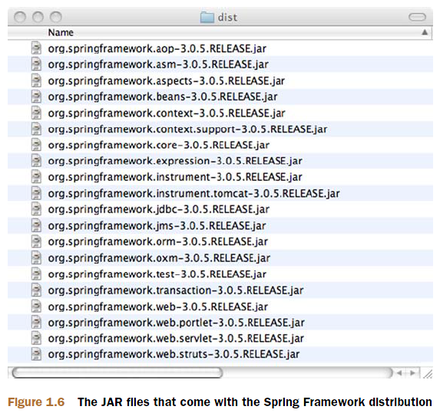
1.3.1 Spring modules

Slide 47
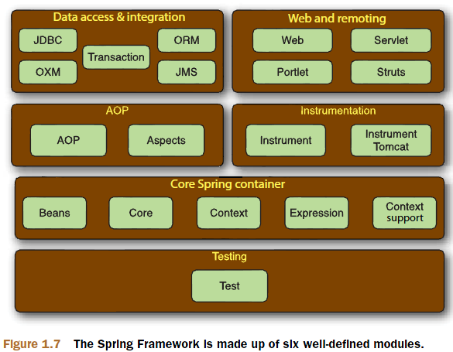
Notes:
-But you don’t have to base your application fully on the Spring Framework.
-Spring even offers integration points with several other frameworks and libraries so that you won’t have to write them yourself.

Slide 48
CORE SPRING CONTAINER
The centerpiece of the Spring Framework is a container that manages how the beans in a Spring-enabled application are created, configured, and managed
In addition to the bean factory and application context, this module also supplies many enterprise services such as email, JNDI access, EJB integration, and scheduling.
SPRING’S AOP MODULE
This module serves as the basis for developing your own aspects for your Spring- enabled application

Slide 49
DATA ACCESS AND INTEGRATION
Spring’s JDBC and data access objects (DAO) module abstracts away the boilerplate code so that you can keep your database code clean and simple, and prevents problems that result from a failure to close database resources
For those who prefer using an object-relational mapping (ORM) tool over straight JDBC, Spring provides the ORM module.
This module also includes a Spring abstraction over the Java Message Service (JMS) for asynchronous integration with other applications through messaging.

Slide 50
WEB AND REMOTING
its web and remoting module comes with a capable MVC framework that promotes Spring’s loosely coupled techniques in the web layer of an application
a servlet-based framework for conventional web applications and a portlet-based application for developing against the Java portlet API
Spring’s remoting capabilities include Remote Method Invocation (RMI), Hessian, Burlap, JAX-WS, and Spring’s own HTTP invoker

Slide 51
TESTING
Recognizing the importance of developer-written tests, Spring provides a module ded- icated to testing Spring applications.

Slide 52
1.3.2 The Spring portfolio
If we stopped at just the core Spring Framework, we’d miss out on a wealth of potential afforded by the larger Spring portfolio. The whole Spring portfolio includes several frameworks and libraries that build upon the core Spring Framework and upon each other. All together, the entire Spring portfolio brings the Spring programming model to almost every facet of Java development.

Slide 53
SPRING WEB FLOW
Spring Web Flow builds upon Spring’s core MVC framework to provide support for building conversational, flow-based web applications that guide users toward a goal (think wizards or shopping carts)
SPRING WEB SERVICES
Spring Web Services offers a contract-first web services model where service implementations are written to satisfy the service contract
SPRING SECURITY
Implemented using Spring AOP, Spring Security offers a declarative security mechanism for Spring-based applications.

Slide 54
SPRING INTEGRATION
Spring Integration offers implementations of several common integration patterns in Spring’s declarative style
SPRING BATCH
If you’re going to be developing a batch application, you can leverage Spring’s robust, POJO-oriented development model to do it using Spring Batch.
SPRING SOCIAL
a social networking extension to Spring
SPRING MOBILE
Spring Mobile is a new extension to Spring to support development of mobile web applications

Slide 55
SPRING DYNAMIC MODULES
Spring Dynamic Modules (Spring-DM) blends Spring’s declarative dependency injection with OSGi’s dynamic modularity. Using Spring-DM, you can build applications that are composed of several distinct, highly cohesive, loosely coupled modules that publish and consume services declaratively within the OSGi framework
SPRING LDAP
Spring LDAP brings Spring-style template-based access to LDAP, eliminating the boilerplate code that’s commonly involved in LDAP operations

Slide 56
SPRING RICH CLIENT
If you’re one of the few still developing Swing applications, you’ll want to check out Spring Rich Client, a rich application toolkit that brings the power of Spring to Swing
SPRING.NET
Spring.NET offers the same loose-coupling and aspect-oriented features of Spring, but for the .NET platform
SPRING-FLEX
The Spring-Flex integration package enables Flex and AIR applications to communicate with server-side Spring beans using BlazeDS.

Slide 57
SPRING ROO
Spring Roo provides an interactive tooling environment that enables rapid devel- opment of Spring applications, pulling together the best practices that have been identified over the past few years
SPRING EXTENSIONS
a community- driven collection of Spring extensions

Slide 58
1.4 What’s new in Spring
The Spring Framework has seen two significant releases, each bringing new features and improvements to ease application development. And several of the other members of the Spring portfolio have undergone major changes

Slide 59
1.4.1 What’s new in Spring 2.5?
Annotation-driven dependency injection through the @Autowired annotation and fine-grained auto-wiring control with @Qualifier
Support for JSR-250 annotations, including @Resource for dependency injection of a named resource, as well as @PostConstruct and @PreDestroy for lifecycle methods.
Auto-detection of Spring components that are annotated with @Component (or one of several stereotype annotations)
An all-new annotation-driven Spring MVC programming model that greatly simplifies Spring web development
A new integration test framework that’s based on JUnit 4 and annotations.

Slide 60
Even though annotations were the big story of Spring 2.5, there’s more:
Full Java 6 and Java EE 5 support, including JDBC 4.0, JTA 1.1, JavaMail 1.4, and JAX-WS 2.0
A new bean-name pointcut expression for weaving aspects into Spring beans by their name
Built-in support for AspectJ load-time weaving
New XML configuration namespaces, including the context namespace for configuring application context details and a jms namespace for configuring message-driven beans.
Support for named parameters in SqlJdbcTemplate.

Slide 61
1.4.2 What’s new in Spring 3.0?
Full-scale REST support in Spring MVC, including Spring MVC controllers that respond to REST-style URLs with XML, JSON, RSS, or any other appropriate response
A new expression language that brings Spring dependency injection to a new level by enabling injection of values from a variety of sources, including other beans and system properties
New annotations for Spring MVC, including @CookieValue and @Request- Header, to pull values from cookies and request headers, respectively
A new XML namespace for easing configuration of Spring MVC

Slide 62
Support for declarative validation with JSR-303 (Bean Validation) annotations
Support for the new JSR-330 dependency injection specification
Annotation-oriented declaration of asynchronous and scheduled methods
A new annotation-based configuration model that allows for nearly XML-free Spring configuration
The Object-to-XML (OXM) mapping functionality from the Spring Web Ser- vices project has been moved into the core Spring Framework

Slide 63
Specifically, starting with Spring 3.0, Java 5 is now required, as Java 1.4 has reached end-of-life and will no longer be supported in Spring.

Slide 64
1.4.3 What’s new in the Spring portfolio?
Spring Web Flow 2.0 was released with a simplified flow definition schema, making it even easier to create conversational web applications.
With Spring Web Flow 2.0 came Spring JavaScript and Spring Faces. Spring JavaScript is a JavaScript library that enables progressive enhancement of web pages with dynamic behavior. Spring Faces allows use of JSF as a view technology within Spring MVC and Spring Web Flow.
The old Acegi Security framework was completely overhauled and released as Spring Security 2.0. In this new incarnation, Spring Security offers a new configuration schema that dramatically reduces the amount of XML required to configure application security.

Slide 65
As you can see, Spring is an active, continuously evolving project. There’s always something new that aims to make developing enterprise Java applications easier.

Slide 66
-End of Chapter 1-

